Slide 1










Music Genre Classification

Slide 2
Music Genre Classification
Table of Content
Research Question
Variables
Classification Model (Logistic Regression)
Prediction Results
Feature Importance
Comparison of Different Models
Conclusion

Slide 3
Music Genre Classification
Research Question
Create a classification model to find the music genre according to the features of the sounds

Slide 4
Music Genre Classification
Variables
Total 60 features, 9990 musics
Filename, Music length and Music Genre
'chroma_stft_mean', 'chroma_stft_var', 'rms_mean', 'rms_var', 'spectral_centroid_mean', 'spectral_centroid_var', 'spectral_bandwidth_mean', 'spectral_bandwidth_var', 'rolloff_mean', 'rolloff_var', 'zero_crossing_rate_mean', 'zero_crossing_rate_var', 'harmony_mean', 'harmony_var', 'perceptr_mean', 'perceptr_var', 'tempo', 'mfcc1_mean', 'mfcc1_var', 'mfcc2_mean', 'mfcc2_var', 'mfcc3_mean', 'mfcc3_var', 'mfcc4_mean', 'mfcc4_var', 'mfcc5_mean', 'mfcc5_var', 'mfcc6_mean', 'mfcc6_var', 'mfcc7_mean', 'mfcc7_var', 'mfcc8_mean','mfcc8_var', 'mfcc9_mean', 'mfcc9_var', 'mfcc10_mean', 'mfcc10_var', 'mfcc11_mean', 'mfcc11_var', 'mfcc12_mean', 'mfcc12_var', 'mfcc13_mean', 'mfcc13_var', 'mfcc14_mean', 'mfcc14_var', 'mfcc15_mean', 'mfcc15_var', 'mfcc16_mean', 'mfcc16_var', 'mfcc17_mean', 'mfcc17_var', 'mfcc18_mean', 'mfcc18_var', 'mfcc19_mean', 'mfcc19_var', 'mfcc20_mean', 'mfcc20_var'
57 variables determine what music genre is

Slide 5
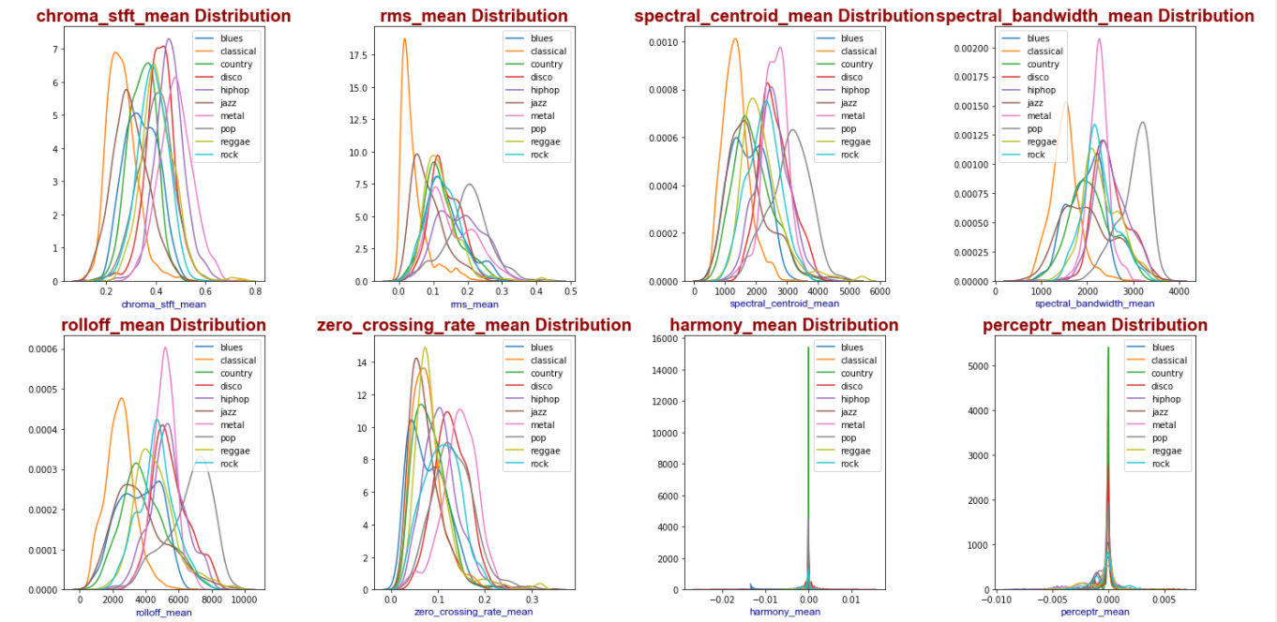
Music Genre Classification
Variables

Slide 6
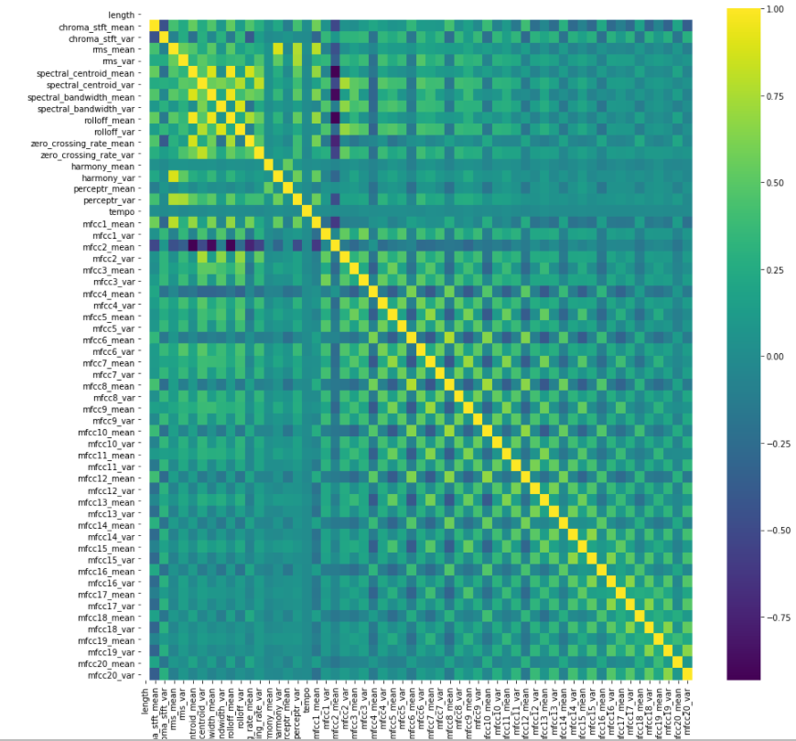
Music Genre Classification
Correlation between Variables
Variables having +0.80 higher correlation
rms_mean
harmony_var
spectral_centroid_mean
spectral_bandwidth_mean
spectral_centroid_mean
rolloff_mean
spectral_centroid_mean
zero_crossing_rate_mean
spectral_centroid_var
zero_crossing_rate_var
spectral_bandwidth_mean
rolloff_mean
spectral_bandwidth_var
rolloff_var
Variables having -0.80 higher correlation
spectral_centroid_mean mfcc2_mean
spectral_bandwidth_mean mfcc2_mean
rolloff_mean mfcc2_mean

Slide 7
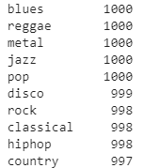
Music Genre Classification
Classification Model
Logistic Regression (C=1)
%80 Train Set
%20 Test Set
Train Set
Accuracy=0.738 (5 Validation Set average accuracy: 0.714)
Test Set
Accuracy=0.728

Slide 8
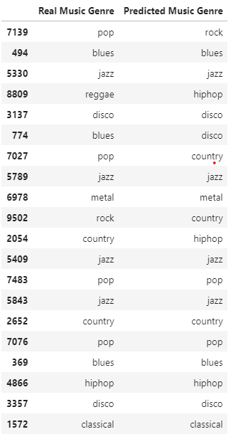
Music Genre Classification
Prediction Results Examples

Slide 9
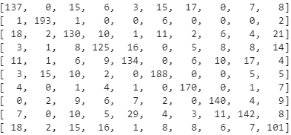
Music Genre Classification
General Prediction of Classification Model
Blues
208
Classical
203
Country
205
Disco
188
Hiphop
198
Jazz
228
Metal
188
Pop
179
Reggae
219
Rock
182
Blues
Classical
Country
Disco
Hiphop
Jazz
Metal
Pop
Reggae
Rock

Slide 10
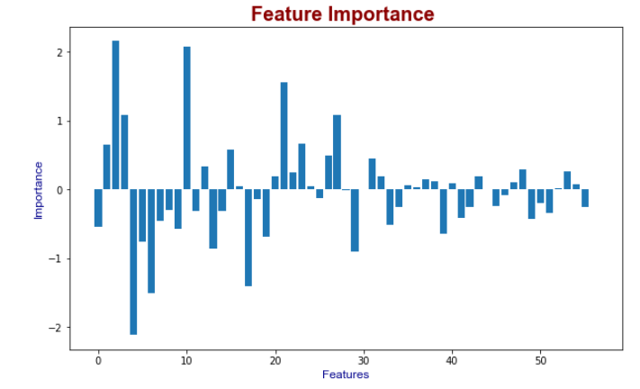
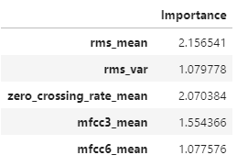
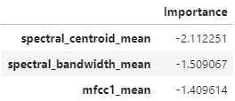
Music Genre Classification
Feature Importance

Slide 11
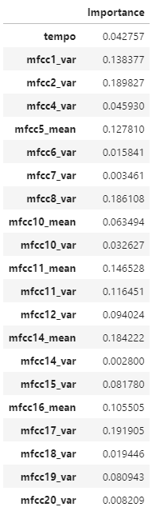
Music Genre Classification
Logistic Regression Model
Train Set (with 36 variable)
Accuracy=0.701
Test Set (with 36 variable)
Accuracy=0.708
21 variable has total of 0.20 accuracy effect at previous model

Slide 12
Music Genre Classification
Comparison of Different Models
Model | Number of Features | Accuracy(Test Set)
Logistic Regression | 57 Variables | 0.728
Logistic Regression | 36 Variables | 0.708
KNeighborsClassifier | 57 Variables | 0.880
RandomForestClassifier | 57 Variables | 0.865
Decision Tree Classification | 57 Variables | 0.641
Support Vector Machine | 57 Variables | 0.863

Slide 13
Music Genre Classification
Conclusion
Logistic Regression has accuracy of 0.728
With 36 Variables Logistic Regression has accuracy of 0.708
KNeighborsClassifier has maximum accuracy value with 0.880

